Slide 1
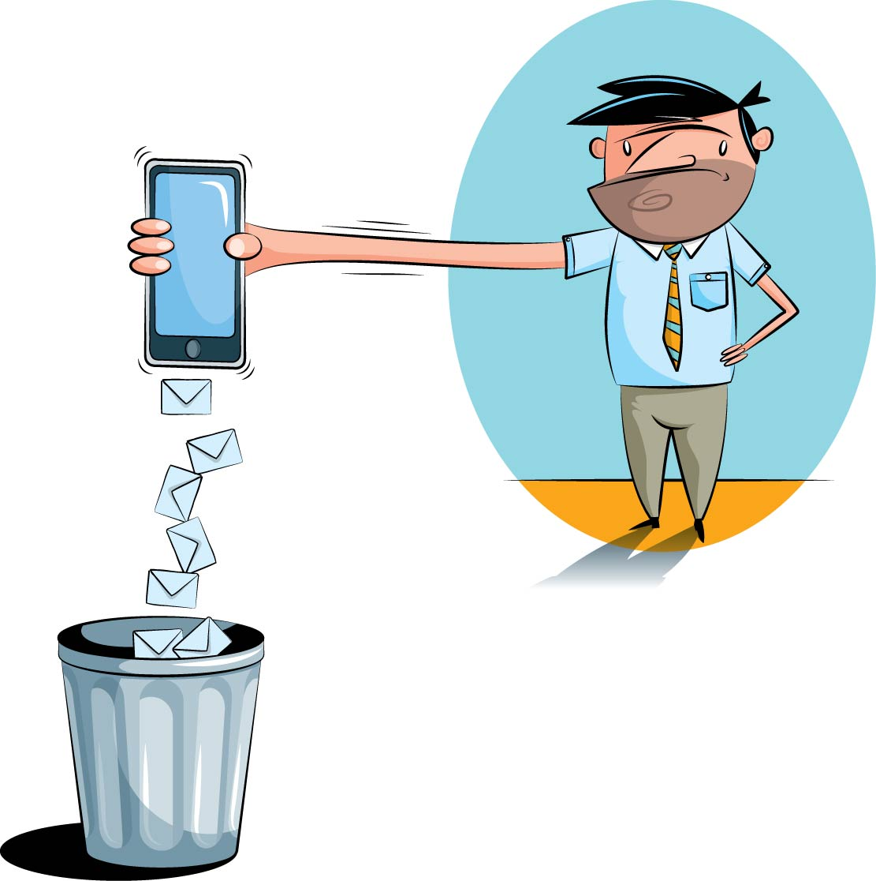
An Analysis of Spam SMS Features
Data Analysis and Research Project
Harshita Jain
n9539361
Supervisor: Dr. Guido Zuccon

Slide 2
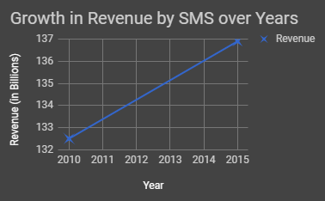
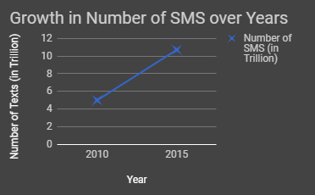
Context
92% of spam SMS are fraud
Overall rate of receipt grew by 300% from 2011 to 2012.

Slide 3
Reason and Effects
Reason
The availability of affordable unlimited pre-pay SMS packages
Customers being more comfortable in sharing their confidential information via SMS
43% of messages were responded in the first 15 minutes of receiving them
Mobile network operators suffer a loss
Higher network costs
Higher operating costs
Increased customer care costs
Tarnished reputation
Annoying for customers
Loss of confidential and valuable personal information
Effects

Slide 4
Gap in Previous Solutions
Simple solutions are used - Blacklisting and Spoofing/Faking Detection
Brittle by nature
Do not take content of messages into account
Require on-going management
Not much data available for research studies
Available datasets are different
Source: http://arrow.dit.ie/cgi/viewcontent.cgi?article=1022&context=scschcomart

Slide 5
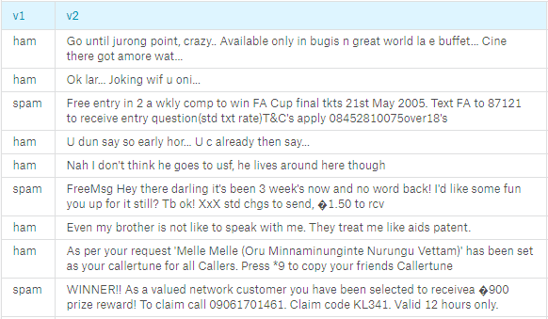
Data Set
Source: Kaggle

Slide 6
Project Purpose and Deliverables
Purpose of the Project:
Analyze the data to understand features that make Spam SMS different from a Legitimate SMS.
Build a predictive model which can accurately predict if an SMS is a Legitimate SMS or a Spam SMS
Project Deliverables:
R Markdown
Analysis Report
Source: https://cacm.acm.org/blogs/blog-cacm/169199-data-science-workflow-overview-and-challenges/fulltext

Slide 8
APPROACH
Data Analysis and Research

Slide 9
Preparation Phase
Input | Output
Acquired data from Kaggle | Key question for Analysis. Clean data.

Slide 10
Exploration Phase
Analyzed Length of Messages v/s Number of Texts for each Label
Manually Selected Differentiating Features of Spam SMS
Verified by Producing Word Cloud for Spam SMS
Visualized Uni-Grams using Bar-Plots
Visualized Bi-Grams and Tri-Grams using Venn Diagram
Input | Output
Clean data | Analysis of features that make a Spam SMS different form a Legitimate SMS

Slide 11
Data Preparation Phase
Prepared Data to be used to Build Predictive Models
Created a Clean Corpus by Transforming Text to Lower-Case, Removing Numbers, Stop Words, Punctuation and White Space.
Split the data into a ratio of 7:3: 70% Training Set and 30% Test Set
Input | Output
Clean data | Data ready to be used to build predictive models.

Slide 12
Classification Phase
Built 4 Different Models for 2 Different Scenarios
Compared each Model for each Scenario
Classifiers used:
Decision Tree
Support Vector Machine
Logistic Regression
Naïve Bayes
Scenario 1: Modelled for the 'manually selected differentiating features' of Spam SMS
Scenario 2: Modelled for 'all the features' of the data
Input | Output
Data from Data Preparation Phase | Precision, Recall, F1 and Accuracy Measures for each model in each scenario Best Scenario for each Model

Slide 13
Reflection Phase
Think Ideas
Meetings with the Supervisor
Communicate Ideas and Observed Output
Input | Output
Output from Exploration Phase Output from Classification Phase | Suggestions to make the project better. New To-Do List.

Slide 14
Final Delivery Phase
Input | Output
Output from Exploration Phase Output from Classification Phase Output from Reflection Phase | Code in R Markdown Analysis Report

Slide 15
Work Done (1)
Analyze the data to understand the differentiating features of Spam SMS.
Explored Length of Messages
Explored words that occur most frequently in Spam SMS.

Slide 16
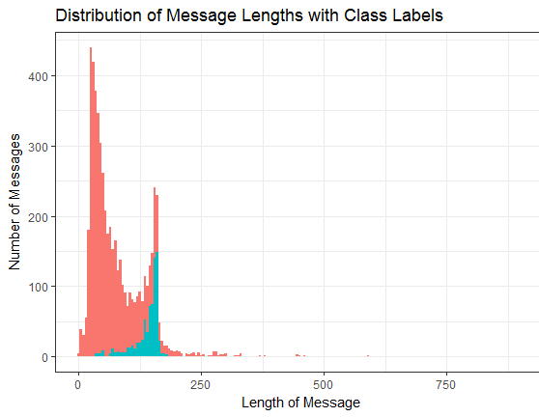
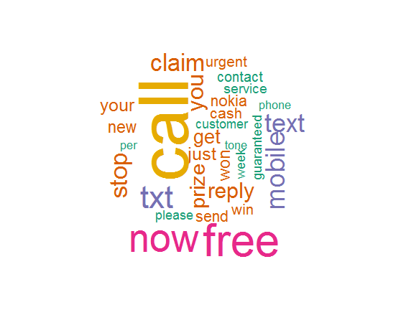
Word Cloud for Messages tagged as Spam
Distribution of Message Lengths v/s Number of Texts

Slide 17
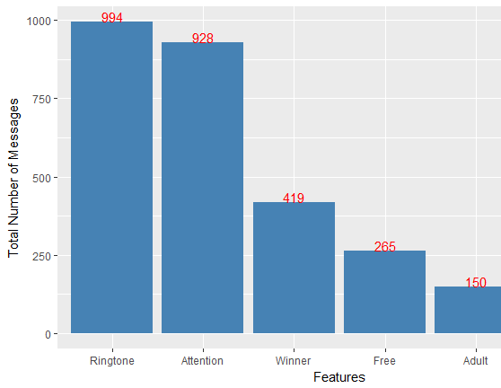
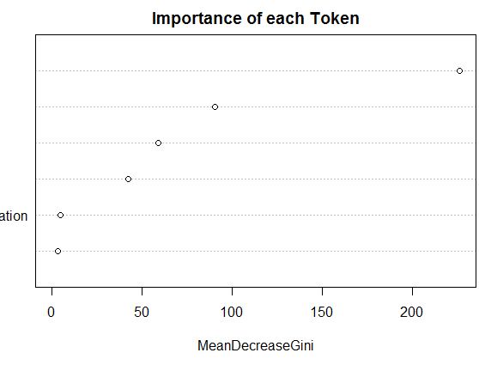
Importance of each Feature
Features v/s Number of Messages

Slide 18
Work Done (2)
Build a predictive model which can accurately predict if an SMS is a Legitimate SMS or a Spam SMS
Built 4 models using different classifiers:
Decision Tree with Random Forest
Support Vector Machine
Logistic Regression
Naïve Bayes
Built on two types of data:
Manually explored and selected 6 most important features of the Spam SMS
All features of the data

Slide 19
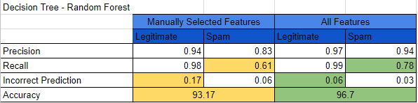
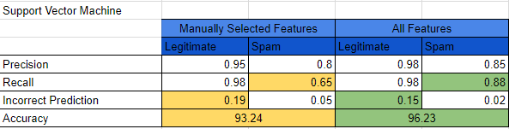

Slide 20

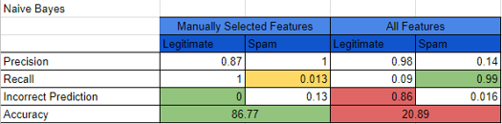

Slide 21
Implications of Work Done
Most Benefitted Stakeholders:
Mobile Network Operators
Implement SMS Spam Filters
Improve SMS Quality and Services to Customers
No Overhead Costs to Maintain the Quality
Consumers
Protected Confidential Personal and Valuable Information

Slide 22
Thank You!!
Any questions?

Slide 23
References
Team, A. V., Shaikh, F., Jain, K., Gupta, A., & Gupta, D. (2016, October 11). A Complete Tutorial to learn Data Science in R from Scratch. Retrieved August 09, 2017, from https://www.analyticsvidhya.com/blog/2016/02/complete-tutorial-learn-data-science-scratch/
Guo, P. (2013, October 30). Data Science Workflow: Overview and Challenges. Retrieved August 09, 2017, from https://cacm.acm.org/blogs/blog-cacm/169199-data-science-workflow-overview-and-challenges/fulltext
Delany, S. J., Buckley, M., & Greene, D. (2012). SMS Spam Filtering: Methods and Data. Retrieved from http://arrow.dit.ie/cgi/viewcontent.cgi?article=1022&context=scschcomart
Whitepapers. (n.d.). Retrieved August 09, 2017, from https://www.cloudmark.com/en/s/resources/whitepapers/sms-spam-overview
(n.d.). Retrieved August 09, 2017, from https://archive.ics.uci.edu/ml/datasets/SMS Spam Collection
The DSDM Agile Project Framework (2014 Onwards). (2017, April 18). Retrieved August 09, 2017, from https://www.agilebusiness.org/resources/dsdm-handbooks/the-dsdm-agile-project-framework-2014-onwards

